Slide 1
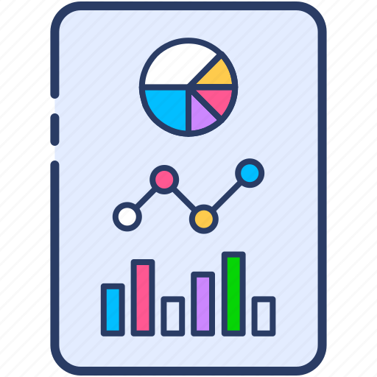
Information Visualization Milestone 01
Team P3-7
Crystal (1901851), Wendy (1901898), Fiona (1901878)

Slide 2

agenda
01
Visualization 1
02
Visualization 2
03
Next Milestone
Background, Data-Task-Idiom, Improvements, Implementation
Background, Data-Task-Idiom, Improvements, Implementation
What will graph will we focus on

Slide 3
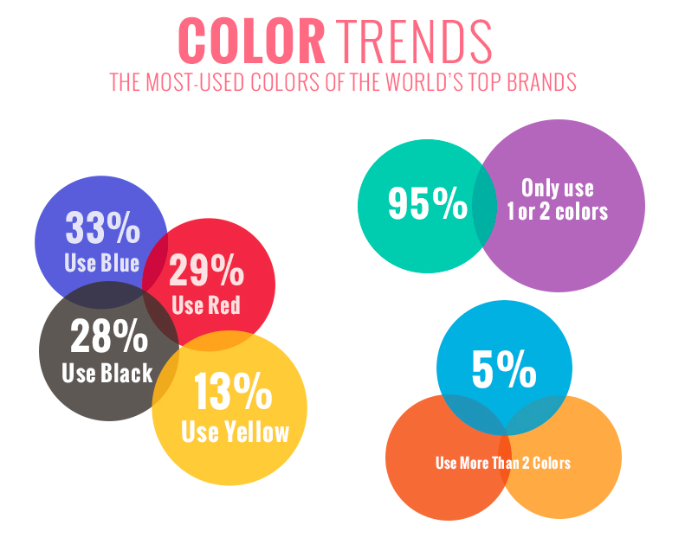
01
Visualization 01
Description, Data-Task-Idiom, Improvements, Implementation

Slide 4
Background
This visualisation was created by an agency called Blueberry Labs and shows the most common colours used by brands.
https://analythical.com/blog/examples-of-awful-data-visualization

Slide 5
Data (What)
33% of the world’s top brand uses blue color, 29% of the world’s top brand uses red color, 28% of the world’s top brand uses black color and 13% of the world’s top brand uses yellow color
In general, 95% uses only 1 or 2 colors from blue, red, black and yellow. 5% remaining uses more than 2 colors
Values on the left != Values on the right
Target Audience: Fashion Designers, Brand Designers

Slide 6
Task (Why)
Visualisation design
Colour
Size
The designer probably wanted to display the visualisation in a more visually appealing way, hence colours were used to represent the respective colours trends which is effective in highlighting the data to help identify the colours easily
Different sizes of circles were used to represent each colour trend, however the size of the circle isn’t relative to the value which is misleading
Overlapping circles are misleading, shows an unintentional venn diagram

Slide 7
Idiom (How)
Marks: Circles
Link marks: Attempts to create a connection between the values and its hypothesis by overlapping one another
Channels: Uses color channel to represent each data
It is not expressive as it fails to express the ranking of each individual colors.
It is not effective as it not clear in answering the most important question of "What is the most popular color for that year".

Slide 8

Improvements
Size of Circle
Avoid Overlapping
More Meaning
Size of circles should be relevant to the value
Avoid overlapping circles unless there is correlation
More meaningful when comparison of colour trends is over a specific of time

Slide 9
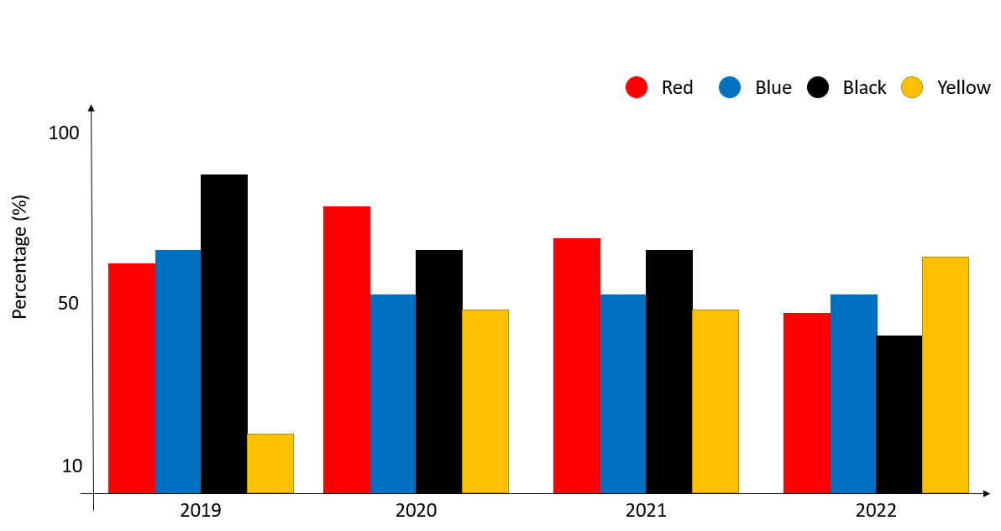
Implementation
X-Axis: Years over a period of time
Y-Axis: Percentage (%) or Value

Slide 10
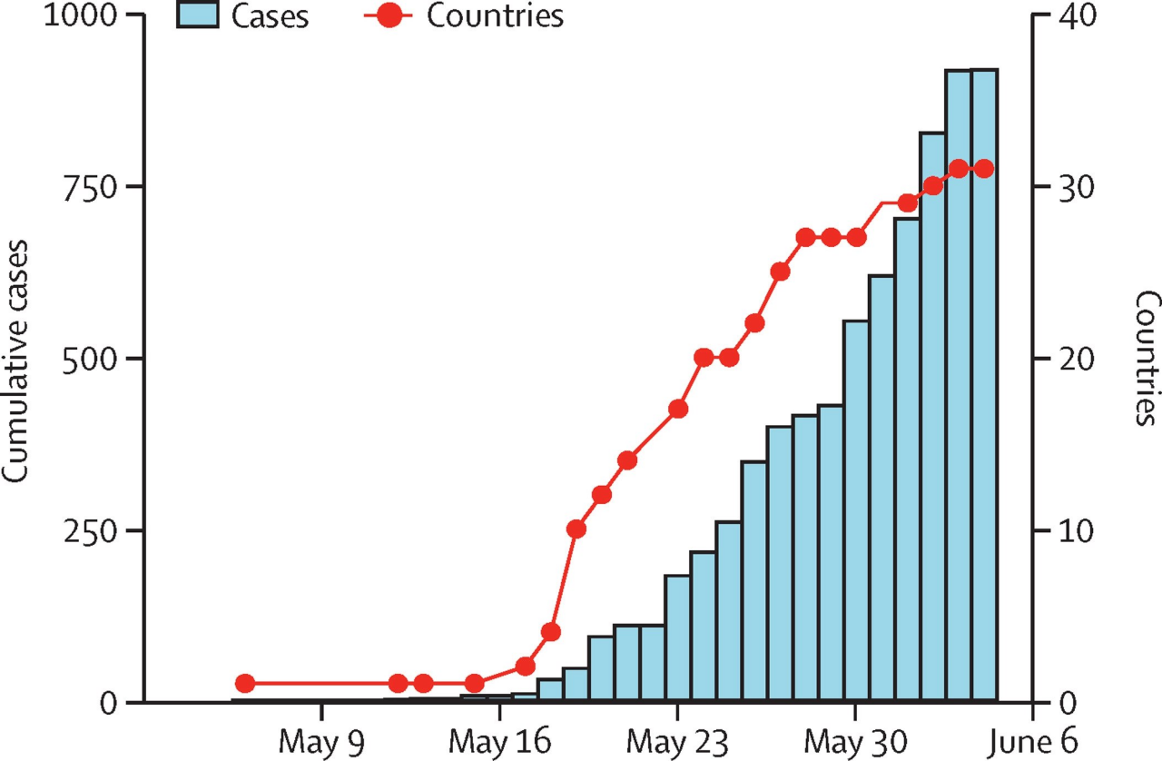
02
Visualization 02
Description, Data-Task-Idiom, Improvements, Implementation

Slide 11
Background
This visualisation was created by the Lancet Infectious Diseases on the 2022 monkeypox outbreak.
https://www.thelancet.com/journals/laninf/article/PIIS1473-3099%2822%2900359-0/fulltext

Slide 12
Data (What)
A line and bar graph on the trend of Monkeypox outbreak in the world
X-axis represent the range of dates
Y-axis represent the number of outbreak/ countries
Target Audience: General Public

Slide 13
Task (Why)
Line graph used to visualise the number of countries which is effective in showing trend/changes over a period of time
Bar chart represents the number of cases which is efficient when comparing the data at a glance

Slide 14
Idiom (How)
The graph does not answer the following question:
What are the specific countries that experience the outbreak
The representation of countries on a linear scale is misleading.
Notes:
Can the smallpox vaccine slow down the rate of infection/lower mortality rate ?
Does gender plays a role in the infection?

Slide 15
Improvements
Add Comparison Data
Use Colors, Line Width and Line Dashes
Choropleth Map
Line graph can compare lots of data at once, would be good to add in different countries data for comparison
More meaningful when comparison of colour trends is over a specific of time
Allow audience to have an overview of the monkeypox cases across different countries

Slide 16
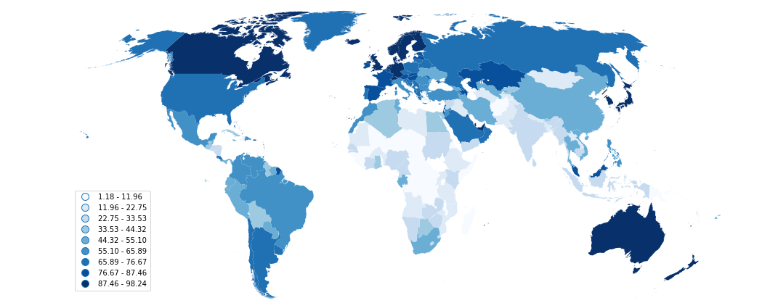
Implementations

Slide 17

03
Next Milestone
Description, Data-Task-Idiom, Improvements, Implementation

Slide 18


Focus on
Visualization 02
https://www.kaggle.com/code/deepcontractor/monkey-pox-dataset

Slide 19

Thank You! :)
Any Question?
Por favor, conserva esta diapositiva para atribuirnos

